Slide 1
FITNESS-RELATED COACHING AND DIET PLANNING MOBILE APPLICATION USING IMAGE PROCESSING AND MACHINE LEARNING
FIT-GENIUS
R24-122

Slide 2
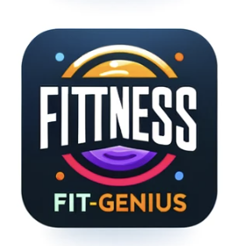
LOGO

Slide 3
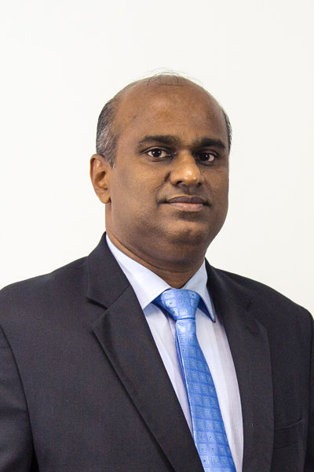

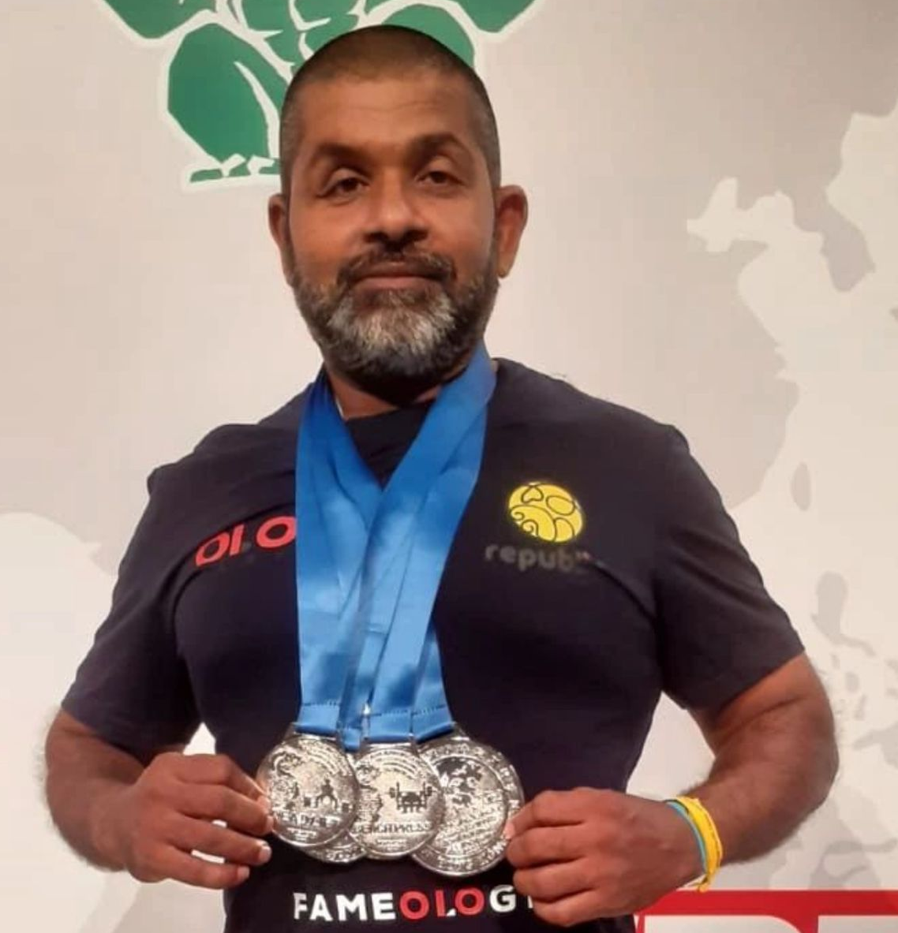


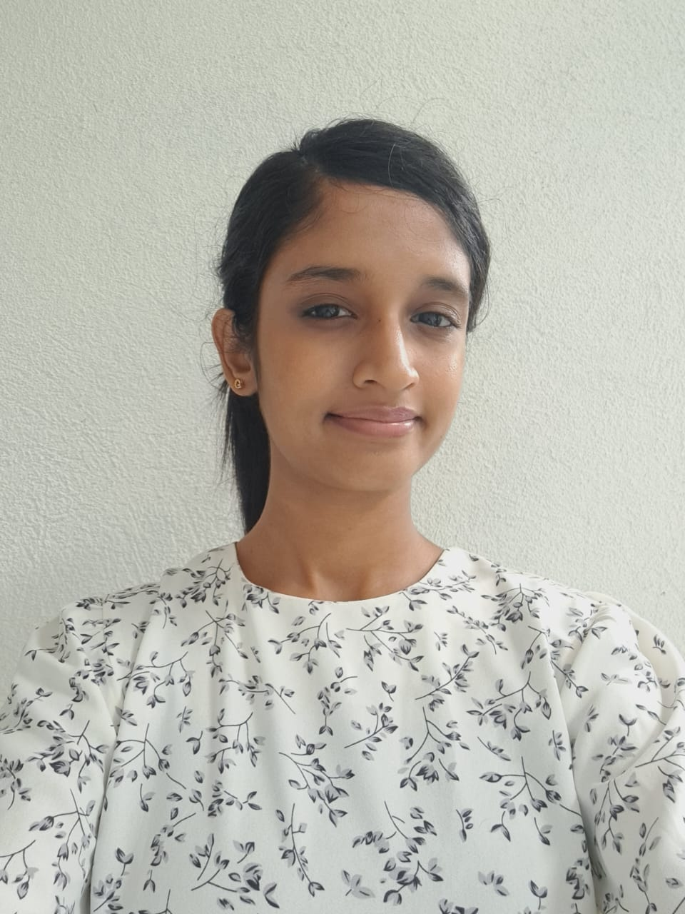
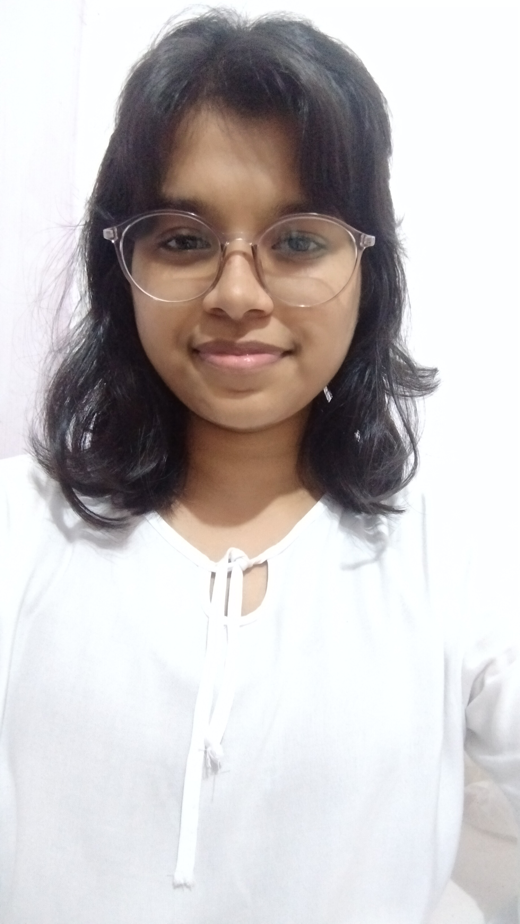
MEET OUR TEAM
Ms. Jenny Krishara
Mr. Chandana Thilakarathne
Prof. Koliya Pulasinghe
CO-SUPERVISOR
SUPERVISOR
EXTERNAL-SUPERVISOR
Ilukpitiya I.M.D.J.R.B
IT21011016
Herath H.M.R.B IT21002106
Rajakaruna R.H.M.S.A IT21114144
Herath M.H.S.M
IT21114144

Slide 4

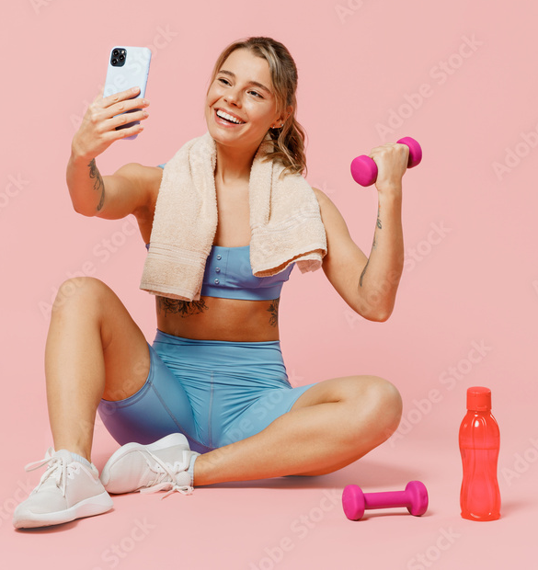
INTRODUCTION
Being physically fit is an essential part of health and wellness.
Modern life is busy; going to the gym is both hard and costly.
Personal trainers also tend to be unaffordable to many people.
Exercise alone won't achieve health goals; a good diet is crucial too.
Customized diet and exercise plans help individual's make the maximize their progress

Slide 5
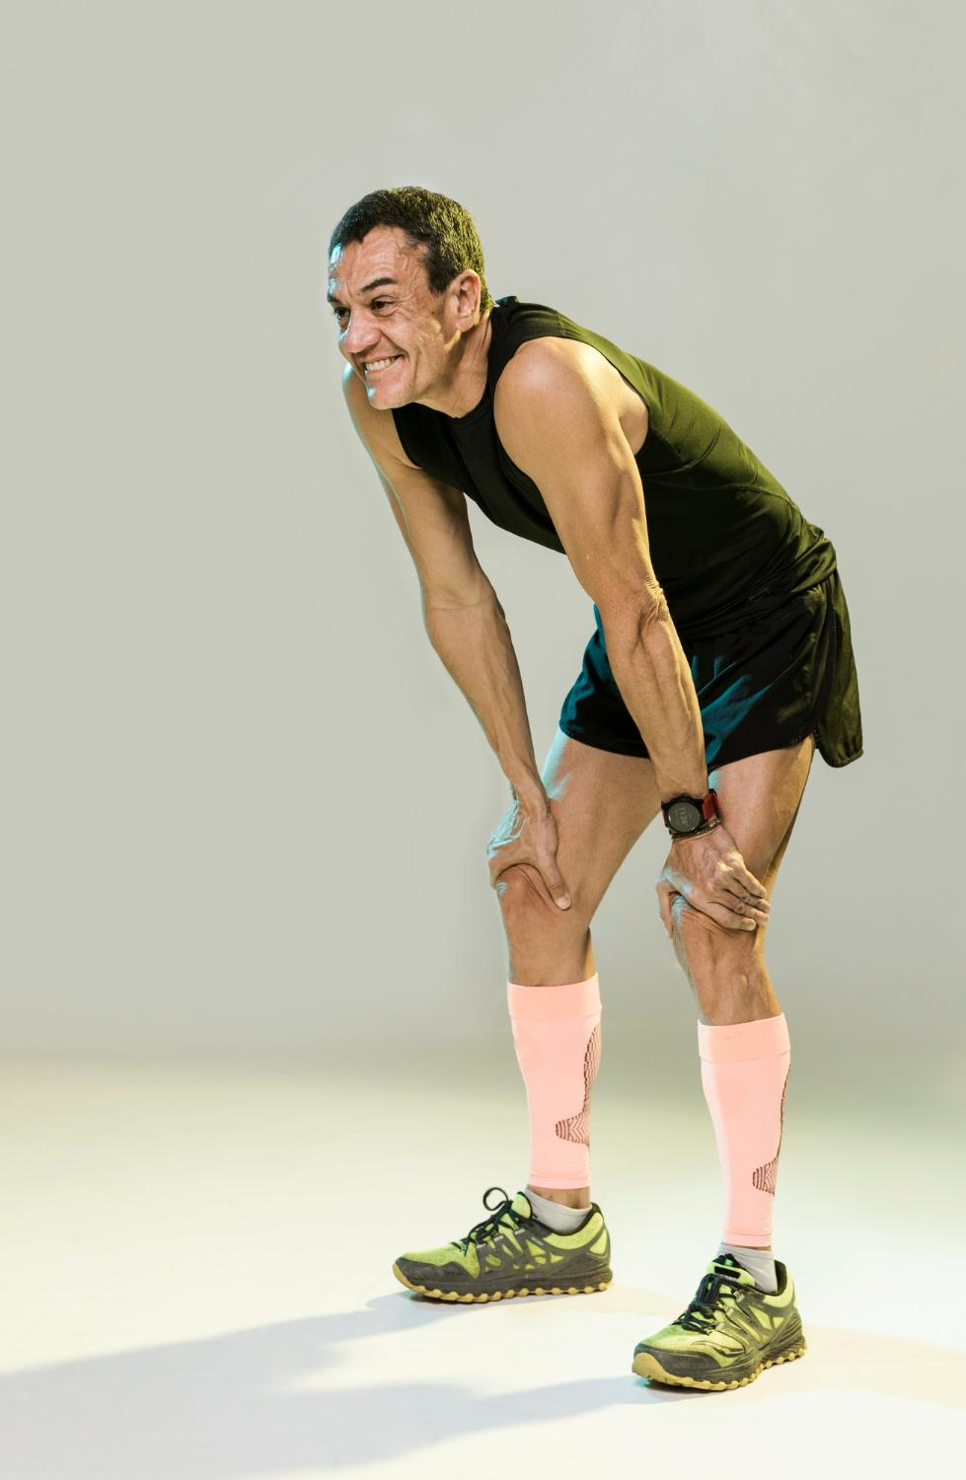





RESEARCH PROBLEM
​
Busy lives make healthy living hard; generic apps and expensive trainers lack personalization
The current apps lack customization, providing only general suggestions.
limited feedback hinders progress, leading to health issues and injuries.
This emphasizes the need for a system offering personalized health advice.

Slide 6
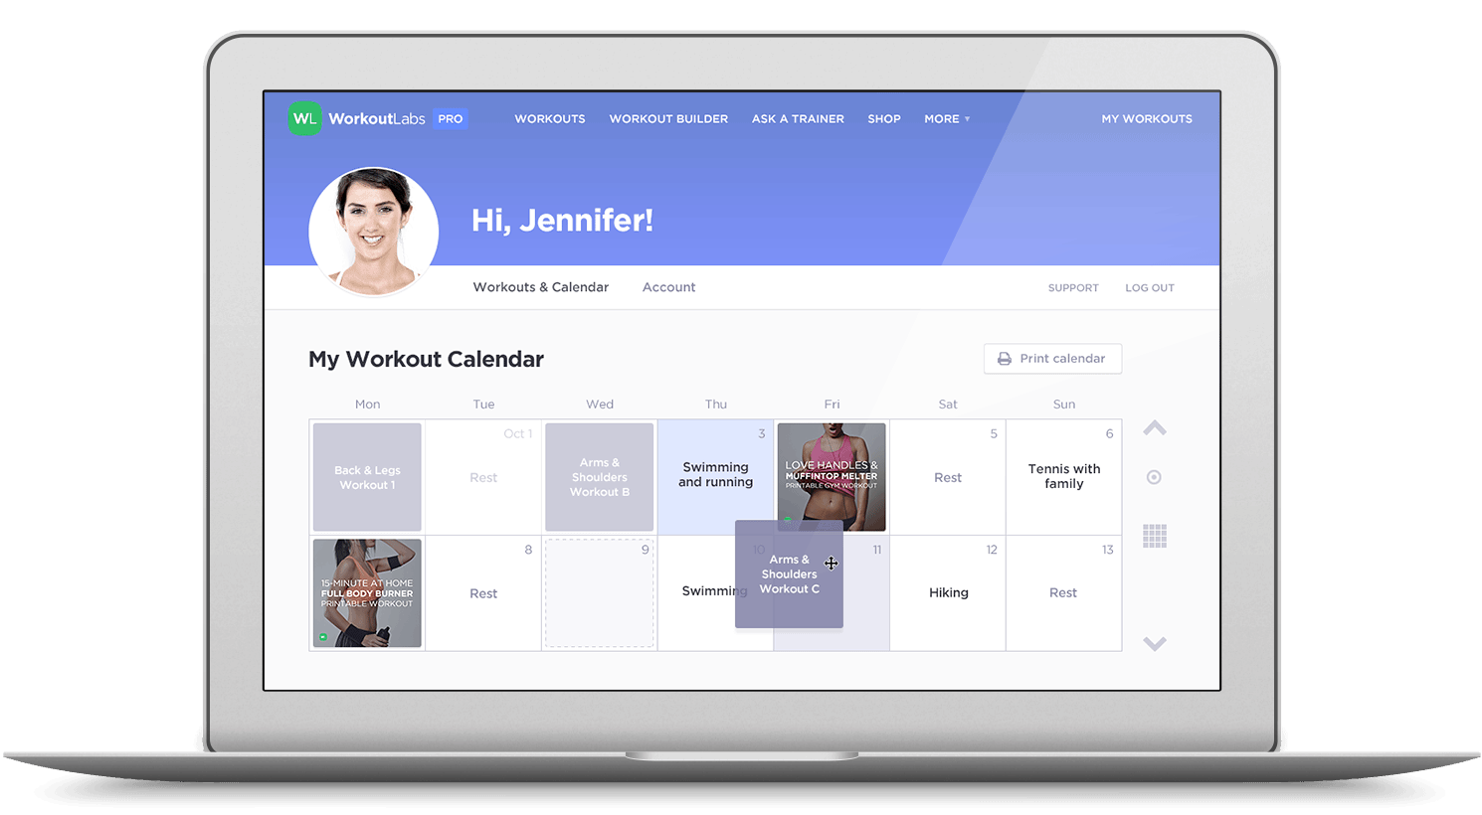
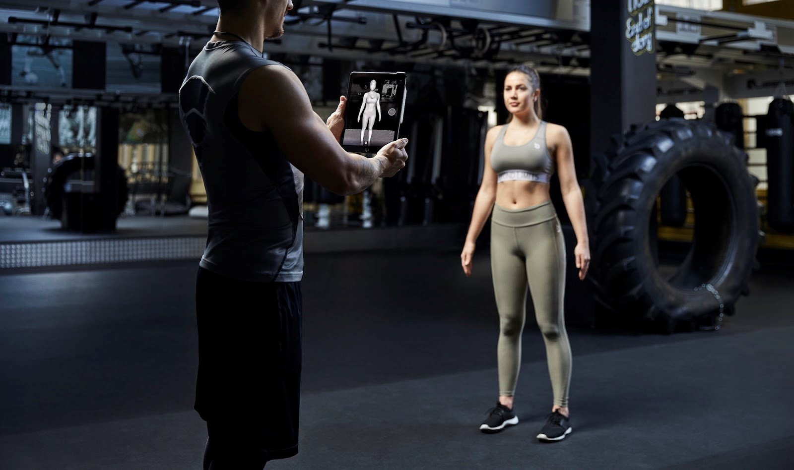


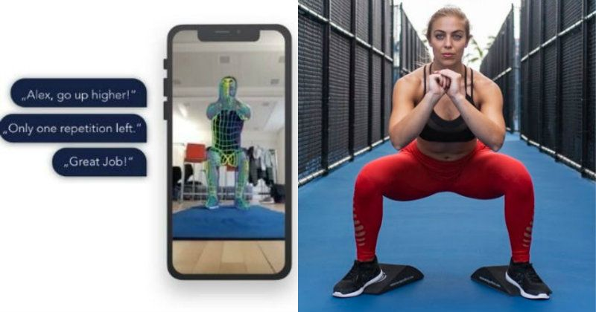
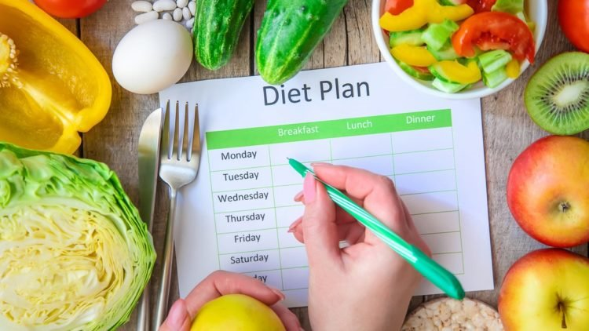


OBJECTIVES
The user needs to upload their upper-body image to analyze and identify their body type through Image Processing.​
Create personalized workout plans by analyzing user responses and body analysis.​
Provide nutritional advice that is specific to everyone based on their responds.​
​
Exercise Movement Tracking System with Real-Time Feedback​

Slide 7
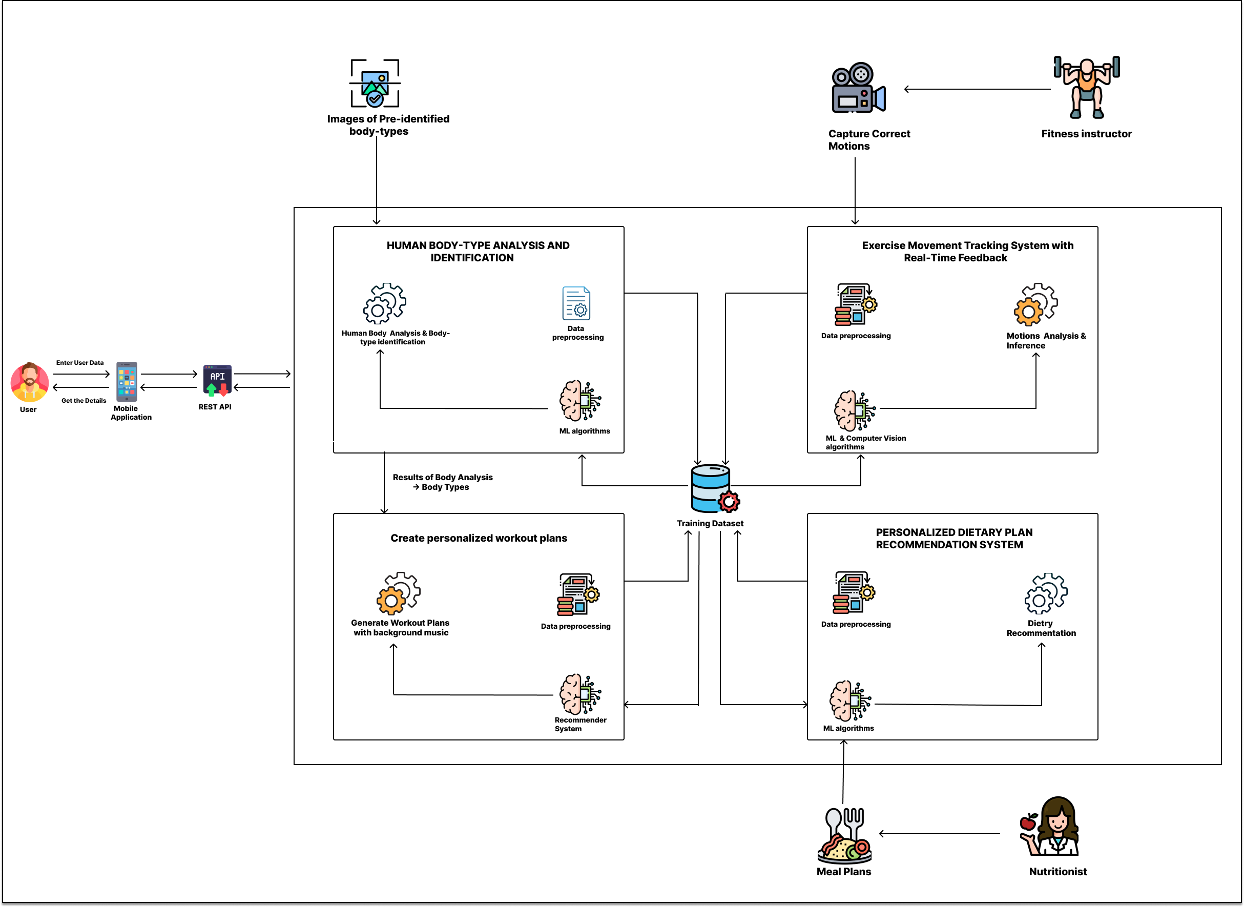
OVERALL SYSTEM DIAGRAM

Slide 8
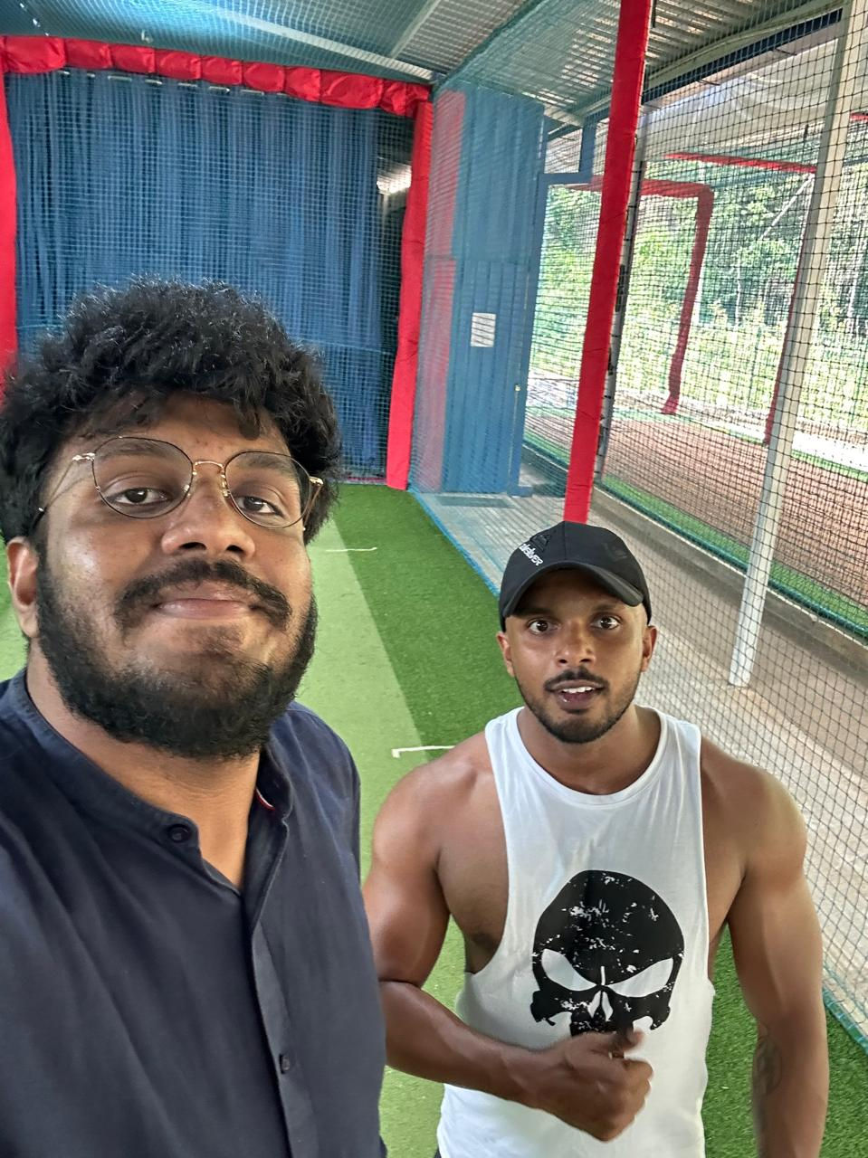
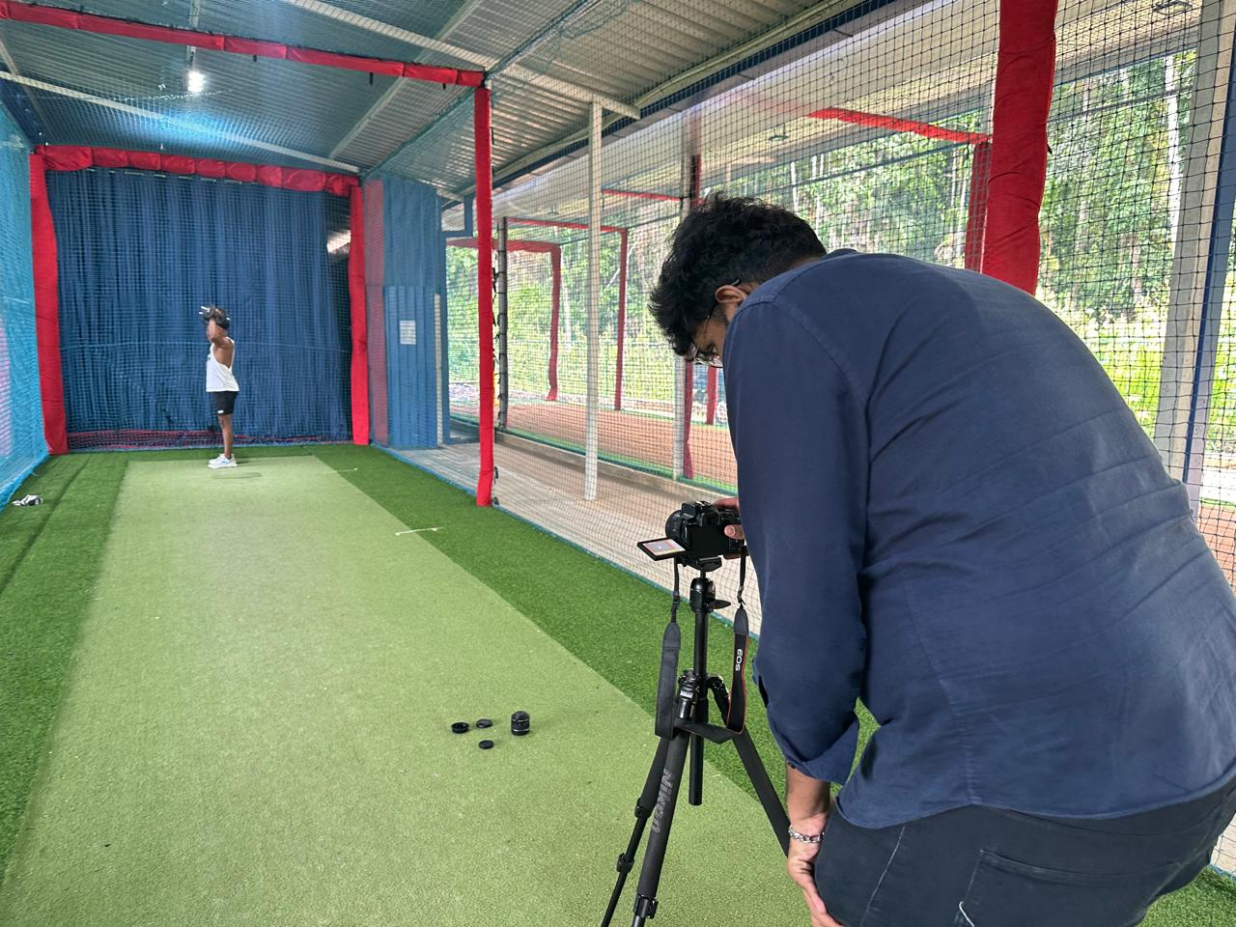
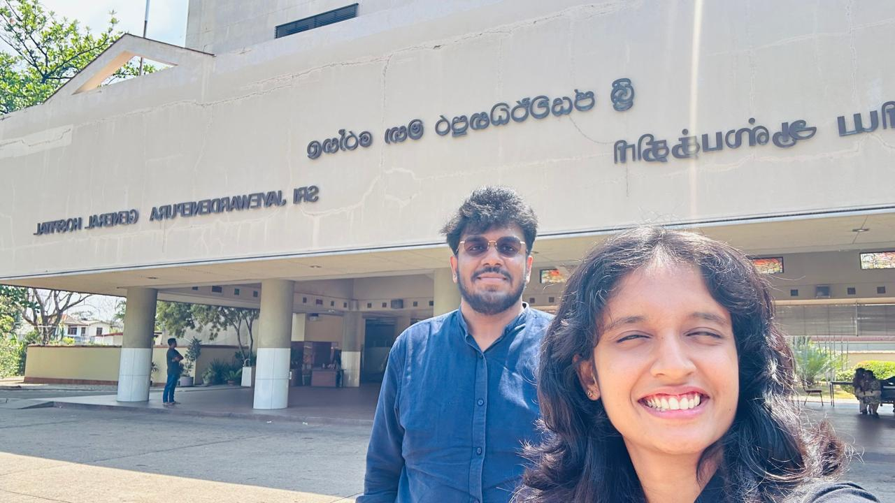
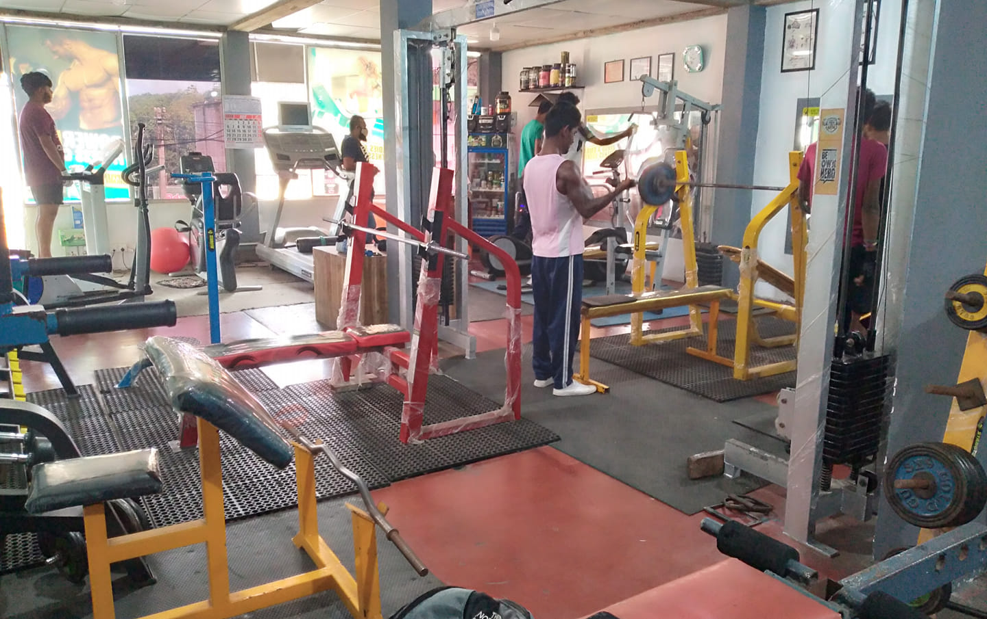
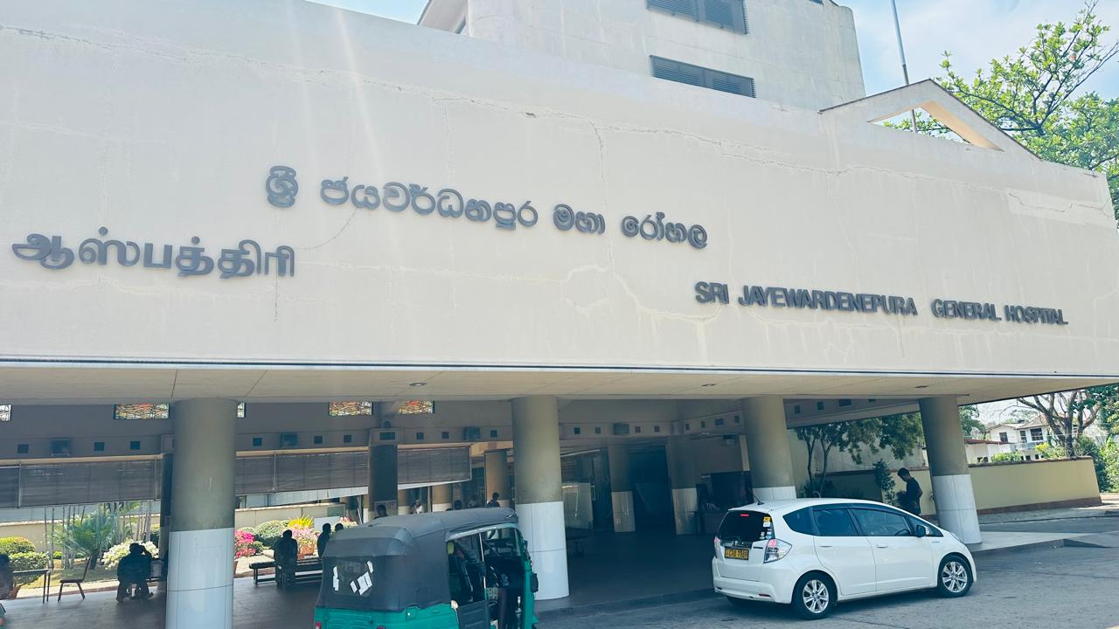
SNAPS OF DATA COLLECTION

Slide 9
IT21011016 | Ilukpitiya I.M.D.J.R.B
Specialization – Information Technology
IT21011016 | Ilukpitiya I.M.D.J.R.B | R24-122

Slide 10
01
HUMAN BODY-TYPE ANALYSIS AND IDENTIFICATION USING IMAGE PROCESSING AND MACHINE LEARNING TECHNIQUES.​
COMPONENT
IT21011016 | Ilukpitiya I.M.D.J.R.B | R24-122

Slide 11
BACKGROUND
What is body-type identification ?​
This is the process of categorizing the users into specific body types based on the physical characteristics of their body.​
We can categorize them into following three primary body types.
Ectomorph​
Mesomorph​
Endomorph​
So, we​
Produce a system that uses image Processing and Machine learning technologies that not only to correctly identifies the client's body type but also makes it easy to reach the fitness goals.​
IT21011016 | Ilukpitiya I.M.D.J.R.B | R24-122

Slide 12
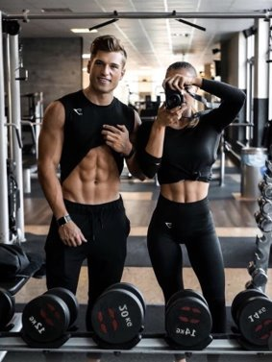
Why We Address?
Identification of body types can help to customize their nutrition and workout plans to suit their unique needs.​
Need knowledge of the body type to personalization of the workout and nutrition plan.​
There may be correlation between specific body types and higher risk of specific medical diseases. So the body analysis helps to prevent it from fitness planning.​
IT21011016 | Ilukpitiya I.M.D.J.R.B | R24-122

Slide 13
Specific Objective
Sub Objective
Identifying characteristics of each body-types.​
​Efficient body type identification​
​Accurate body analysis​
​
Develop a system to identify the body type using image processing technology and suggest the most suitable body goal to predict the body transformation timeline. ​
IT21011016 | Ilukpitiya I.M.D.J.R.B | R24-122

Slide 14
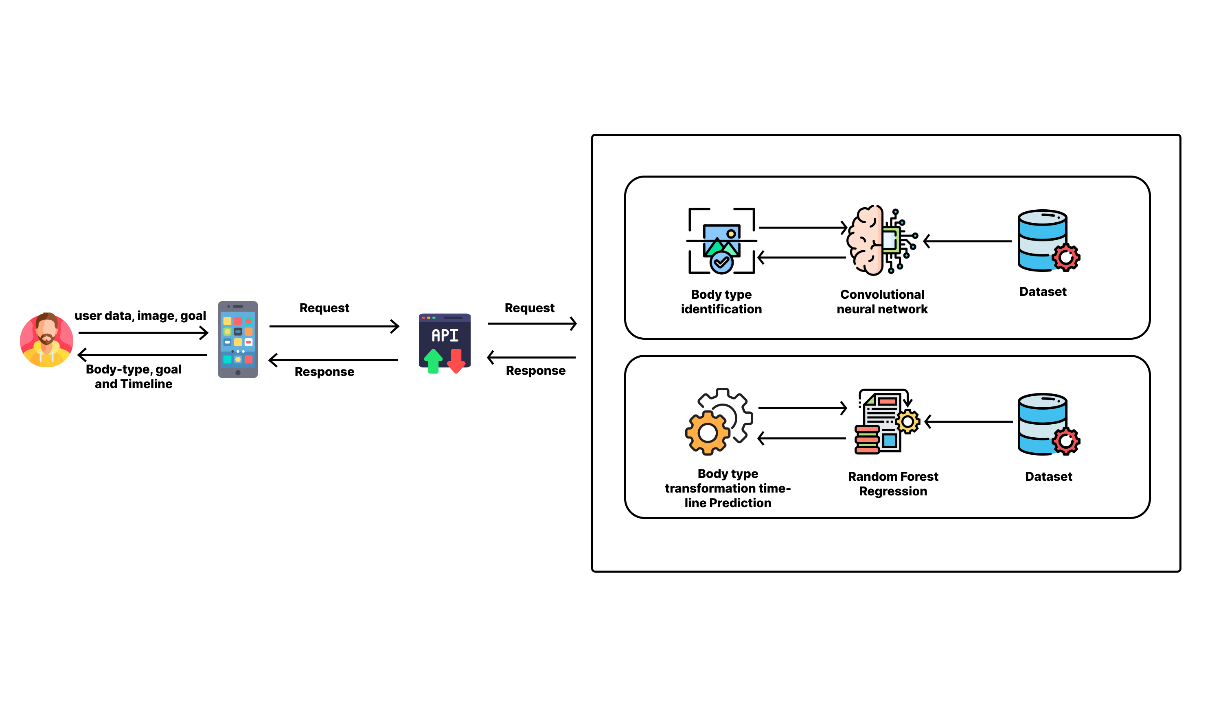
SYSTEM DIAGRAM
IT21011016 | Ilukpitiya I.M.D.J.R.B | R24-122

Slide 15
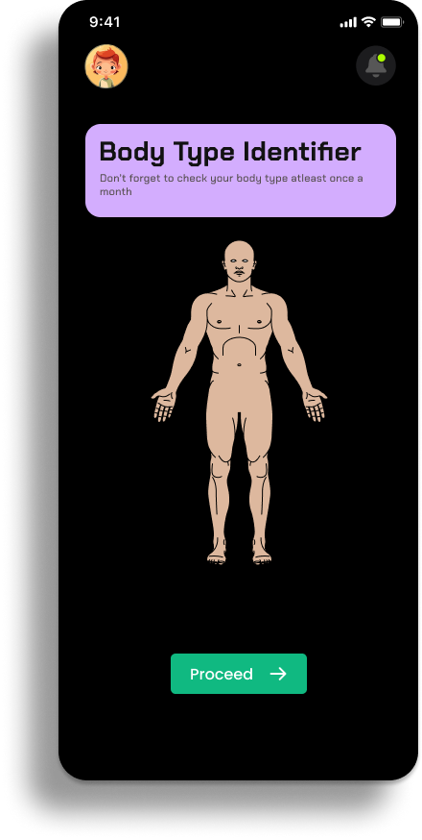
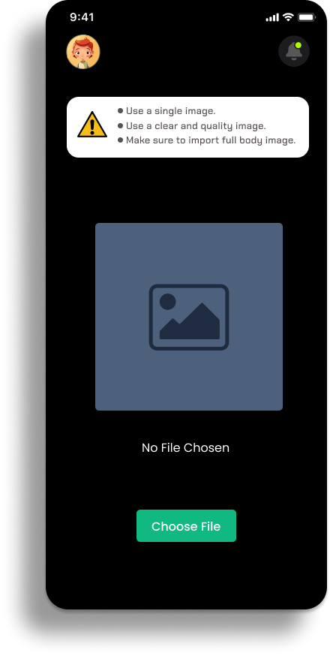
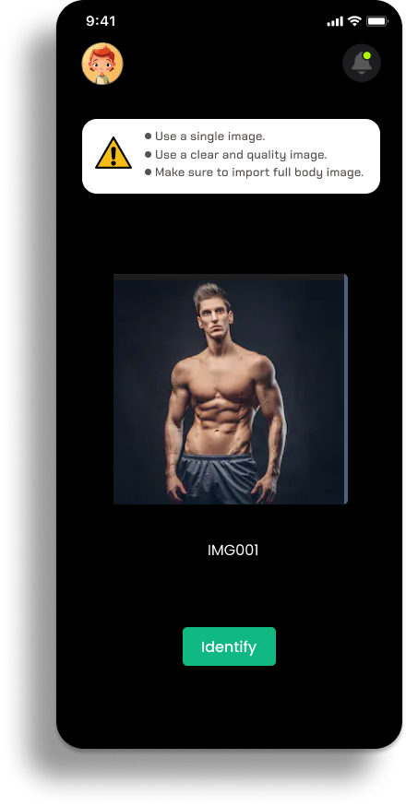
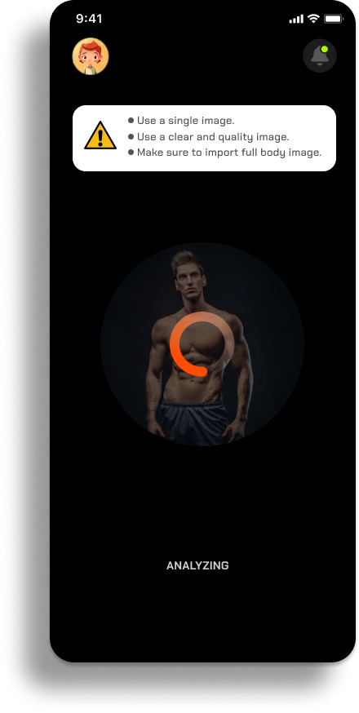
FIGMA UI
IT21011016 | Ilukpitiya I.M.D.J.R.B | R24-122

Slide 16
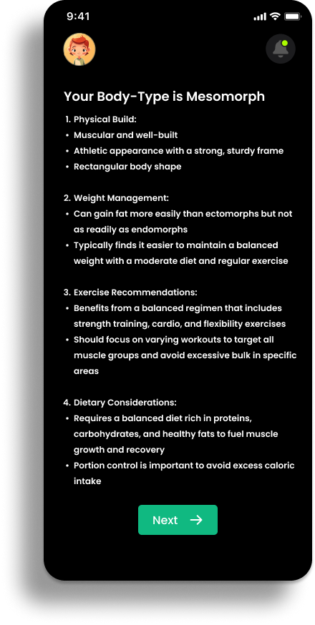
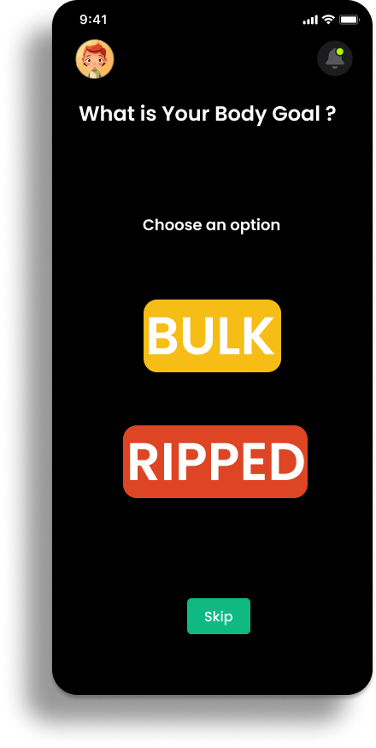
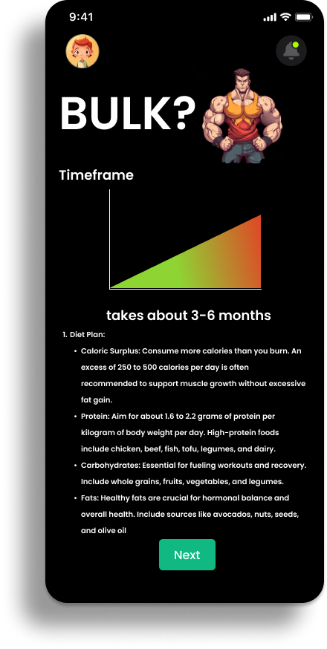
FIGMA UI
IT21011016 | Ilukpitiya I.M.D.J.R.B | R24-122

Slide 17





TECHNOLOGIES
Flutter
python
TensorFlow
OpenCV
Firebase
IT21011016 | Ilukpitiya I.M.D.J.R.B | R24-122

Slide 18
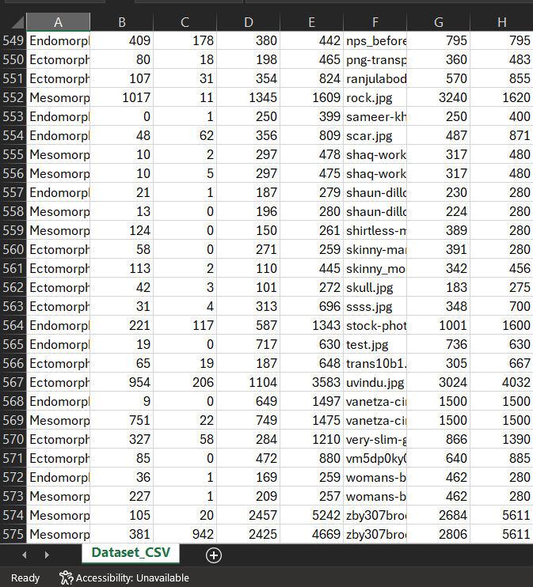
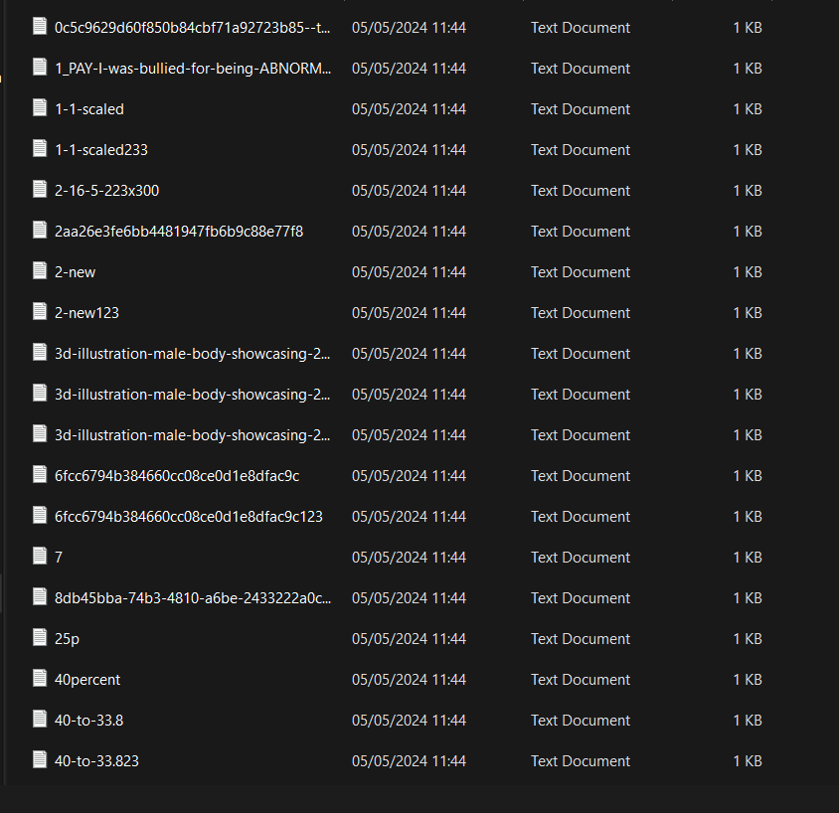
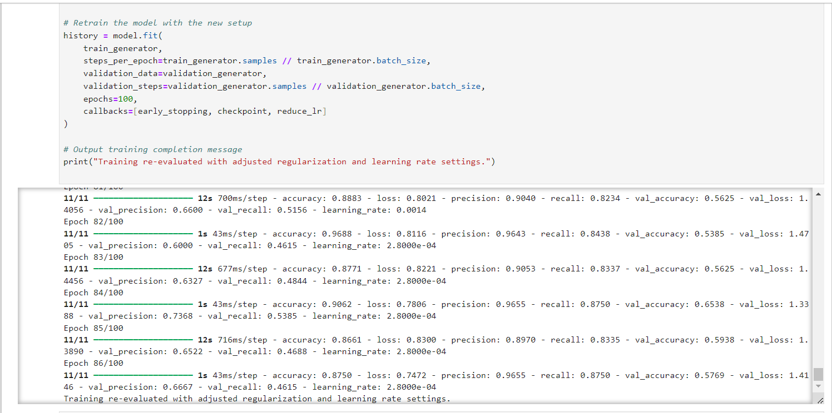
EVIDENCE OF COMPLETION
DATASETS
IT21011016| Ilukpitiya I.M.D.J.R.B | R24-122

Slide 19
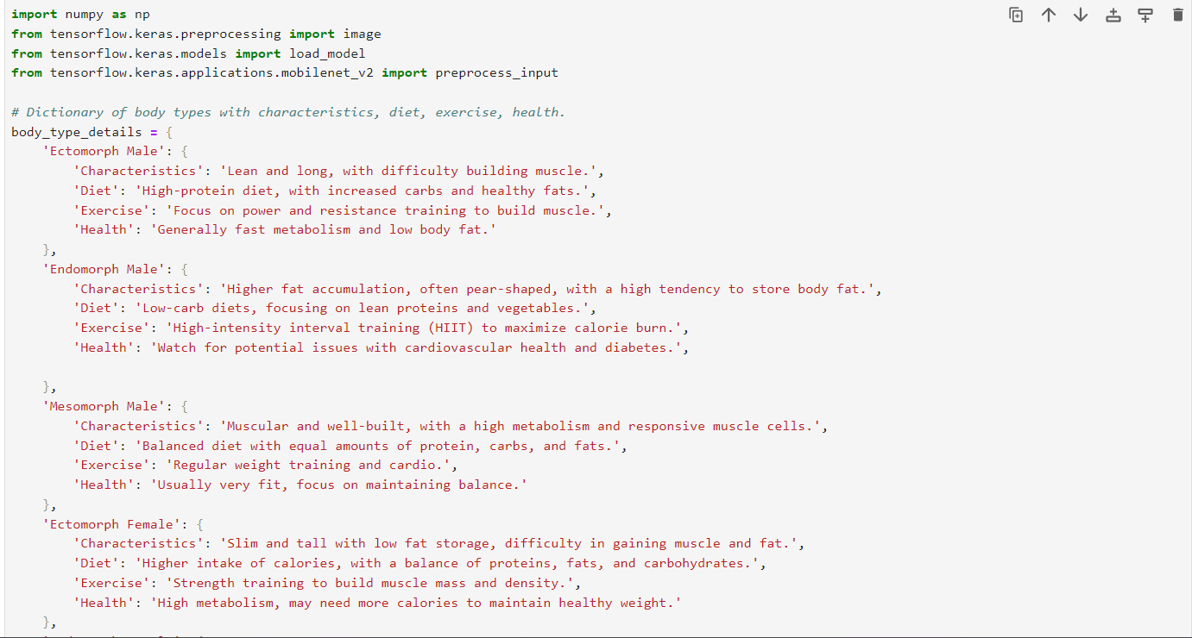
EVIDENCE OF COMPLETION
CNN Image classifier - Identify Body Type
IT21011016 | Ilukpitiya I.M.D.J.R.B | R24-122

Slide 20
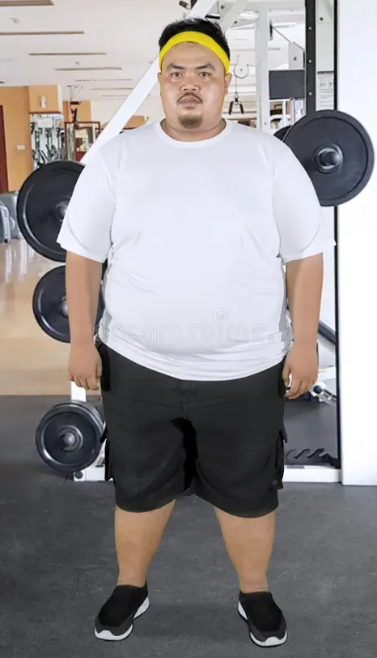
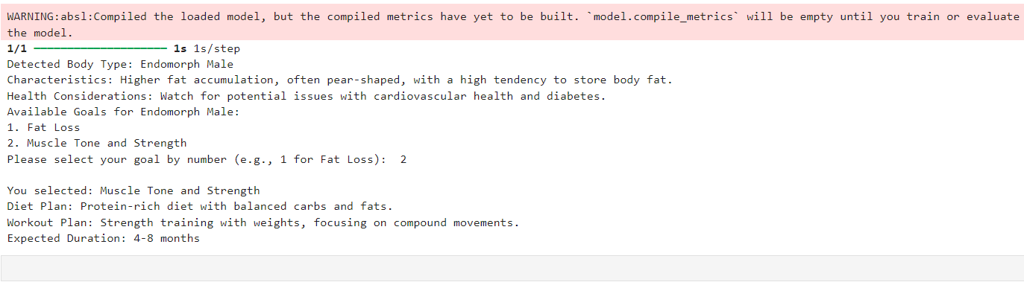
EVIDENCE OF COMPLETION
Test & Outputs
IT21011016 | Ilukpitiya I.M.D.J.R.B | R24-122

Slide 21
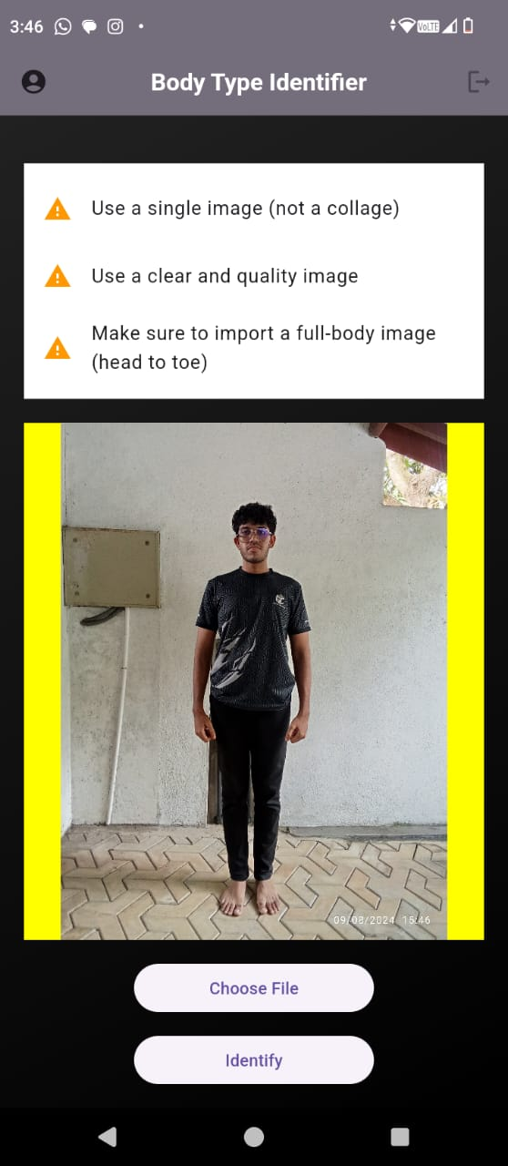
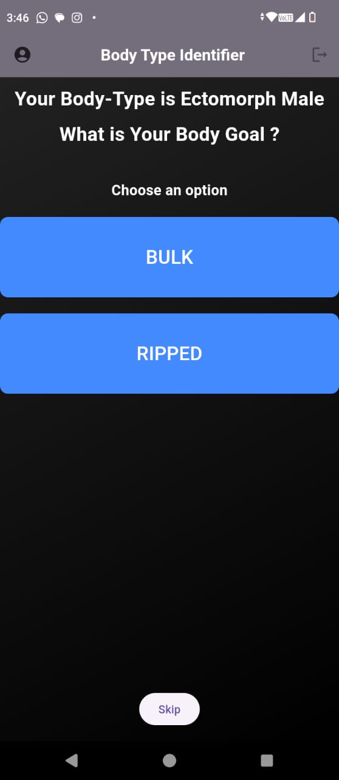
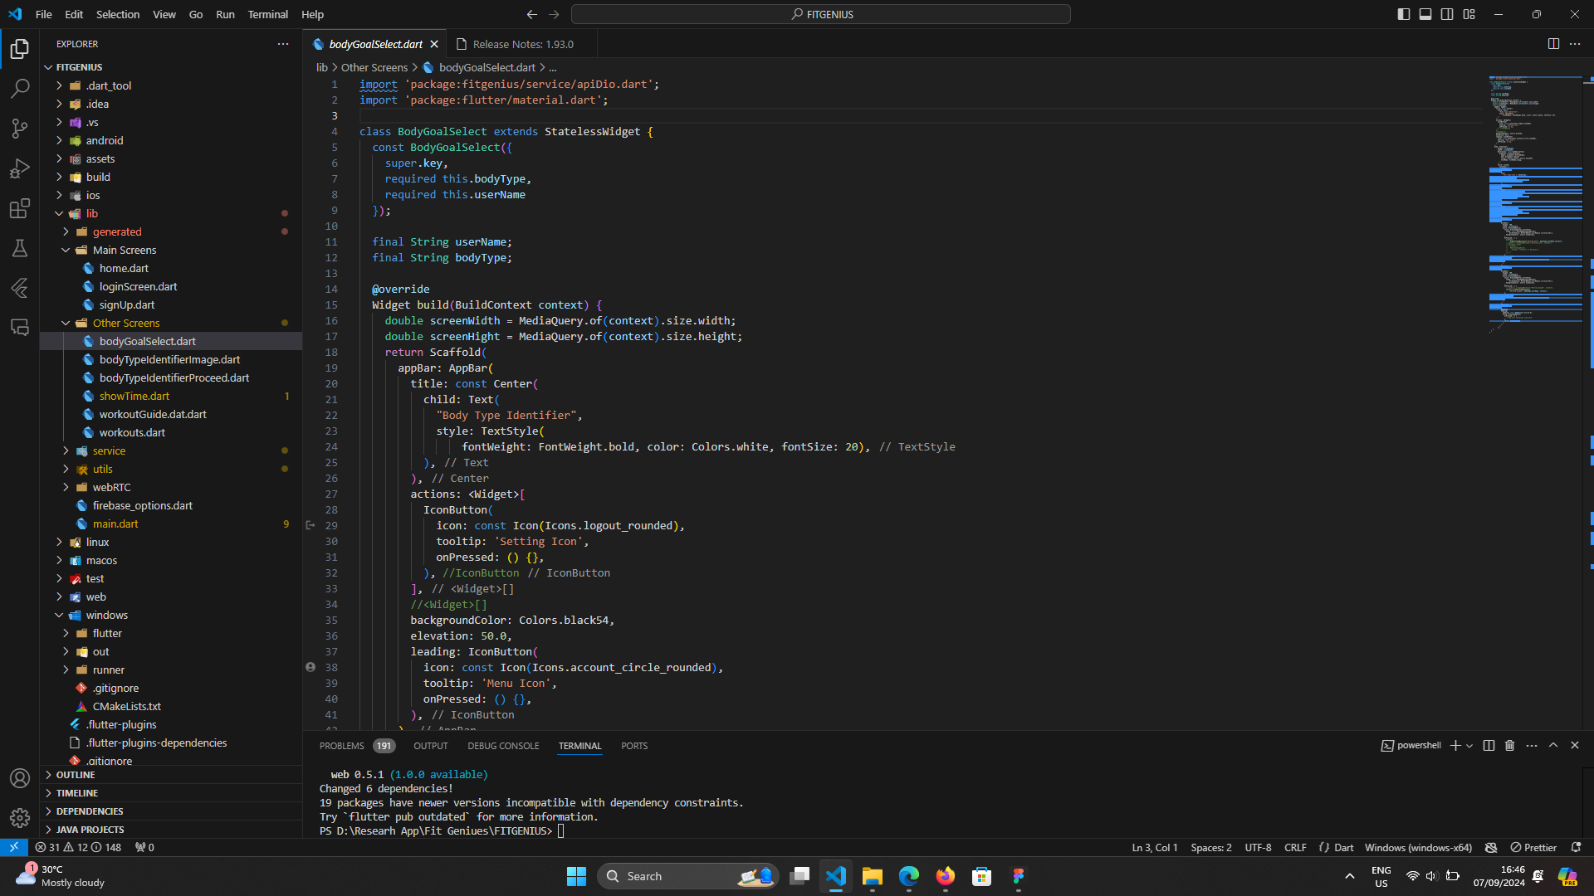
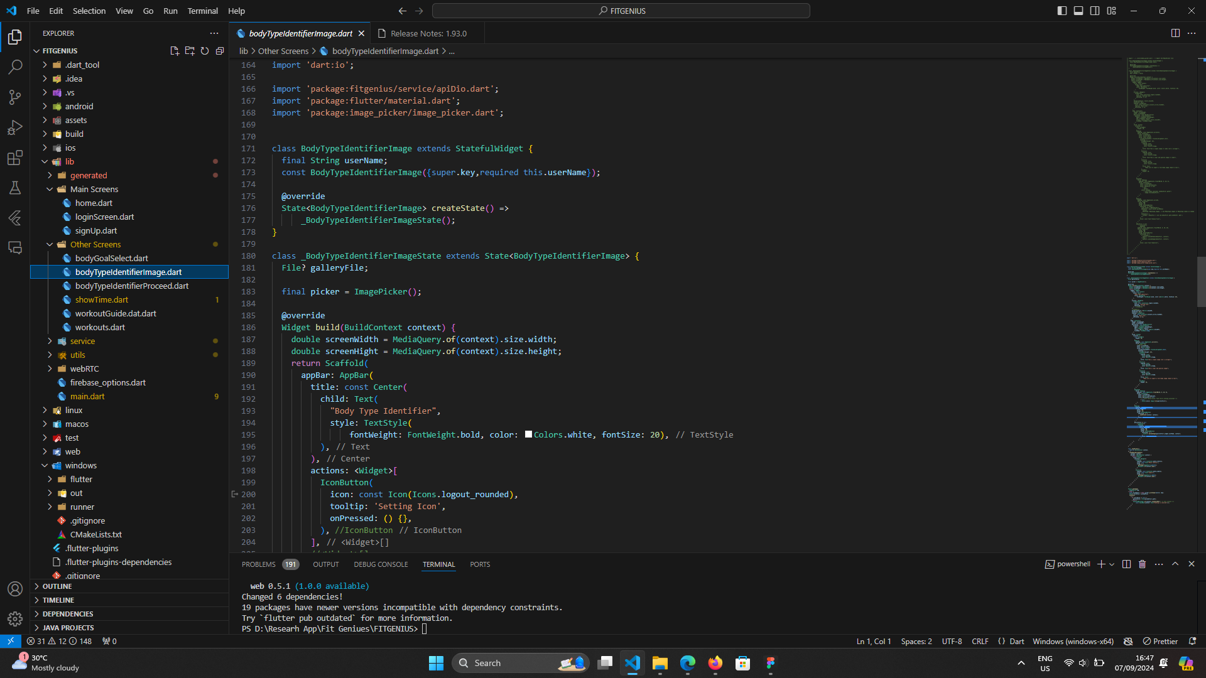
EVIDENCE OF COMPLETION
Frontend Implementation
IT21011016 | Ilukpitiya I.M.D.J.R.B | R24-122

Slide 22
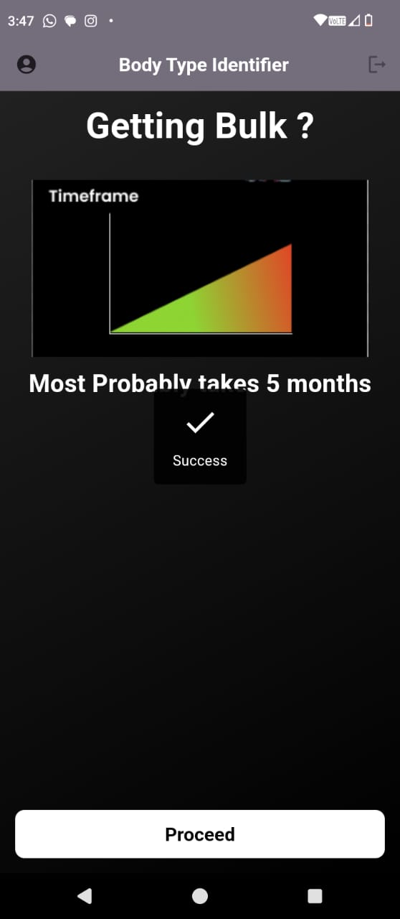
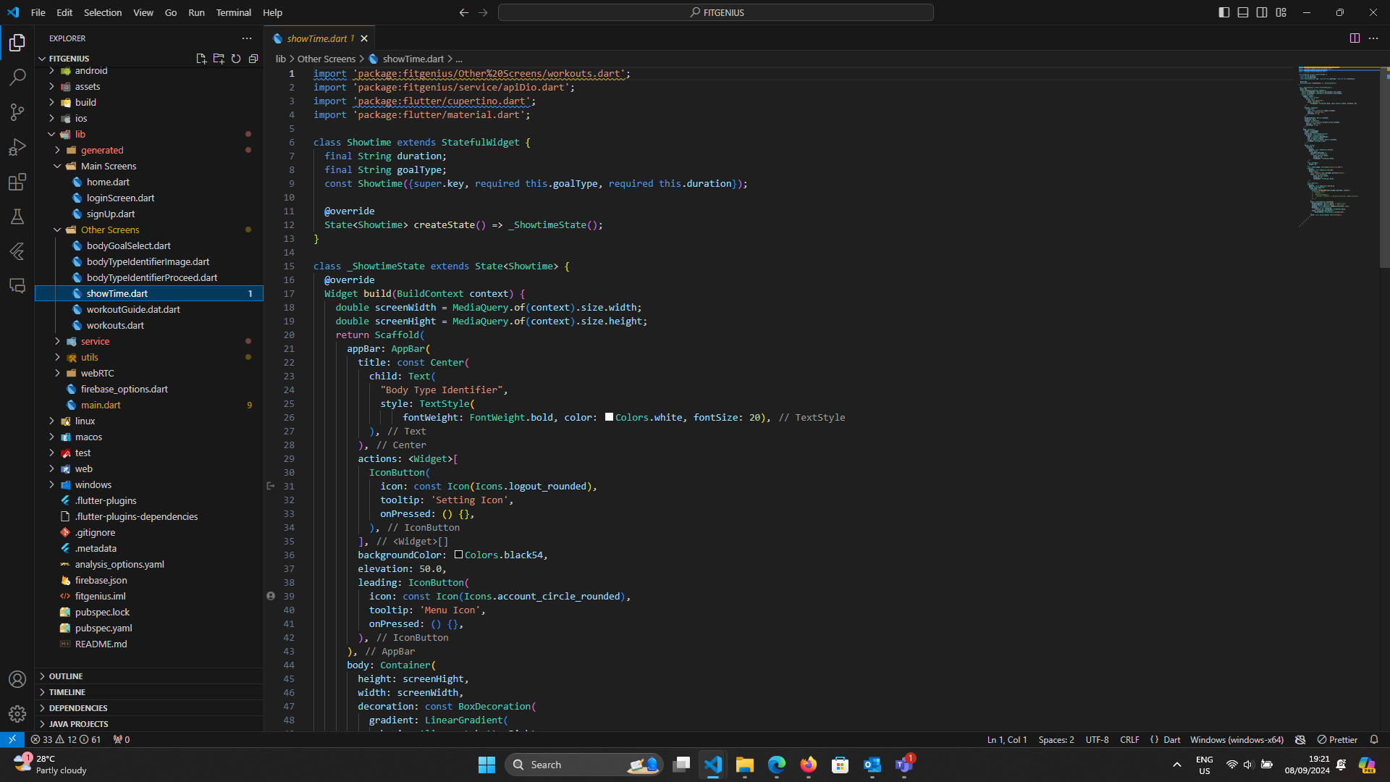
EVIDENCE OF COMPLETION
Frontend Implementation
IT21011016 | Ilukpitiya I.M.D.J.R.B | R24-122

Slide 23
Overall Progress
Completed Tasks
Data Preprocessing & Preparing
Problem Identification
Research & Data Collection
On going Tasks
CNN model & Random Forest Regressor model
Fine Tuning the Model & Algorithm
Tasks yet to start
OVERALL PROGRESS
Capture Videos and Obtain real-time Predictions
Author a research paper and submit
Improve the User Interface Design
Testing
90%
User Interface Design
Deployment & Evaluation
Integration
commercialization
IT21011016 | Ilukpitiya I.M.D.J.R.B | R24-122

Slide 24
FUTURE WORKS
Make the model more advanced to identify body types
Enhance the UI / UX
Enhance user experiences
IT21011016 | Ilukpitiya I.M.D.J.R.B | R24-122

Slide 25

REQUIREMENTS
Non-Functional
Requirements
Software
Requirements
Functional Requirements
Python
Body Analysis and Body-Type Identification​
Performance
Jupyter Notebook
User Interaction and Engagement​
Accuracy
Flutter
Visual Studio Code
Real-Time Feedback and Guidance
Compatibility
Personal
Requirements
Reliability
Resources and To Create Dataset
Online Resources
IT21011016 | Ilukpitiya I.M.D.J.R.B | R24-122

Slide 26
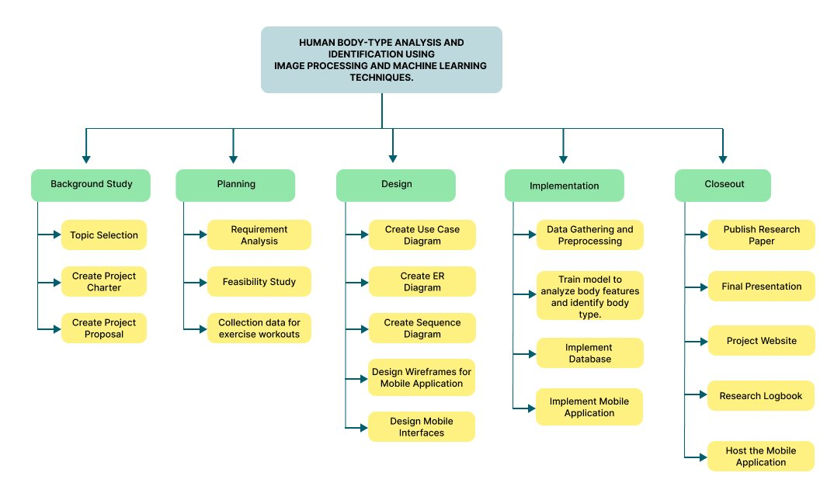
WORK BREAKDOWN STRUCTURE
IT21011016 | Ilukpitiya I.M.D.J.R.B | R24-122

Slide 27
IT21114144 | Herath M.H.S.M
Specialization – Information Technology
IT21114144 | Herath M.H.S.M | R24-122

Slide 28
02
PERSONALIZED WORKOUT PLANS THROUGH ADVANCED BODY ANALYSIS AND CUSTOM RESPONSES​
COMPONENT
IT21114144 | Herath M.H.S.M | R24-122

Slide 29
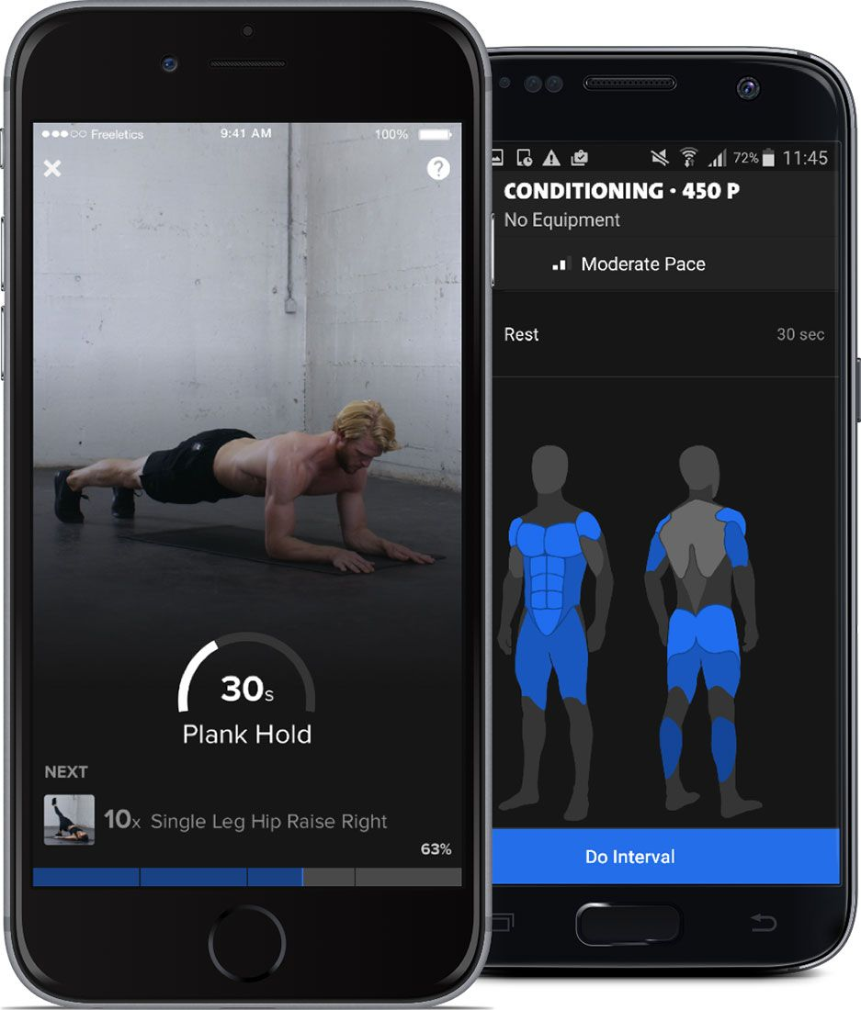
BACKGROUND
What is the purpose of implementing Emoji Feedback Function
Focus mental & emotional well being
Satisfaction with workouts
IT21114144 | Herath M.H.S.M | R24-122

Slide 30
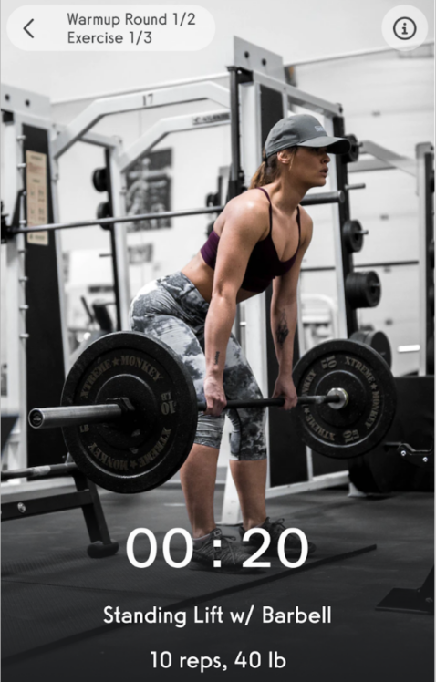
Why We Address?
It could be difficult to concentrate on health in the face of busy lifestyles and time constraints.
We are creating a system that uses machine learning and algorithms to create customized workouts depending on body analysis to solve this.
IT21114144 | Herath M.H.S.M | R24-122

Slide 31
Specific Objective
Provide a customized workout planning tool that improves user experience before, during, and after workouts by utilizing body analysis data, and emoji feedback
Sub Objective
Data Gathering for Workout Plan Generation
Algorithm Implementation for Personalized Workout Recommendations
IT21114144 | Herath M.H.S.M | R24-122

Slide 32
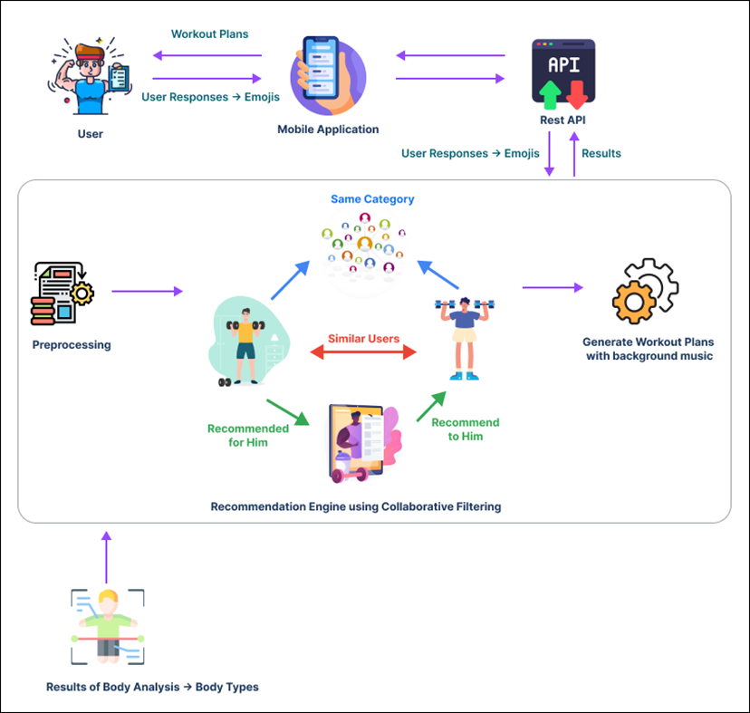
SYSTEM DIAGRAM
IT21114144 | Herath M.H.S.M | R24-122

Slide 33
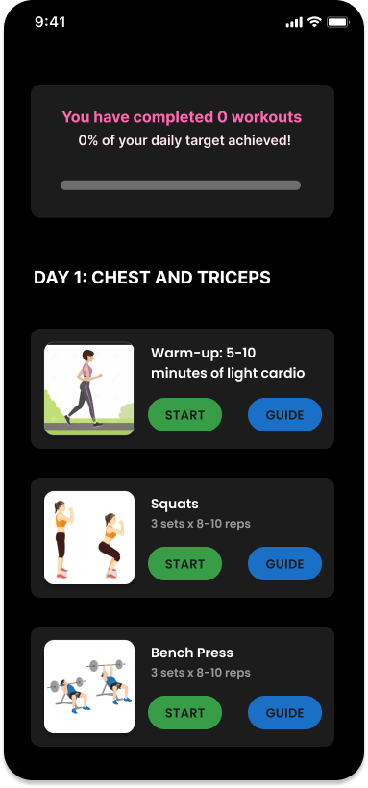
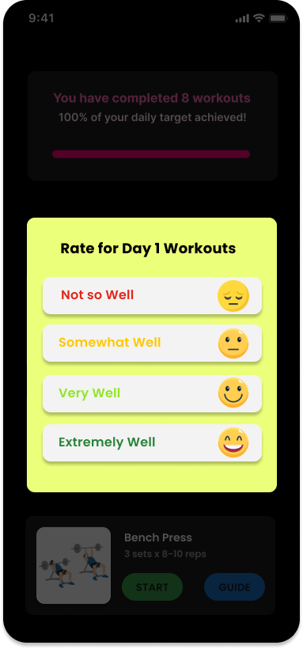
FIGMA UI
IT21114144 | Herath M.H.S.M | R24-122

Slide 34
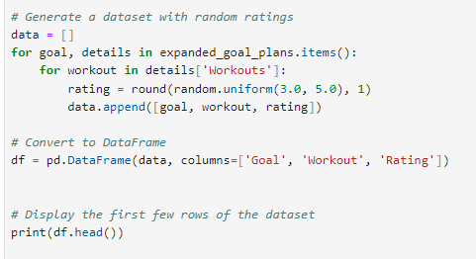
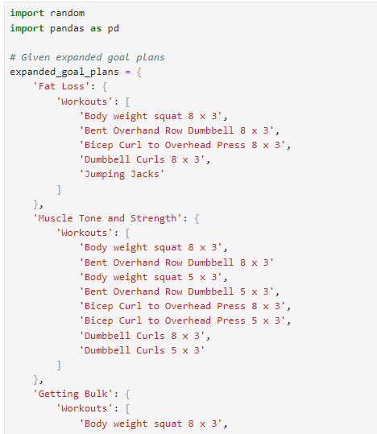
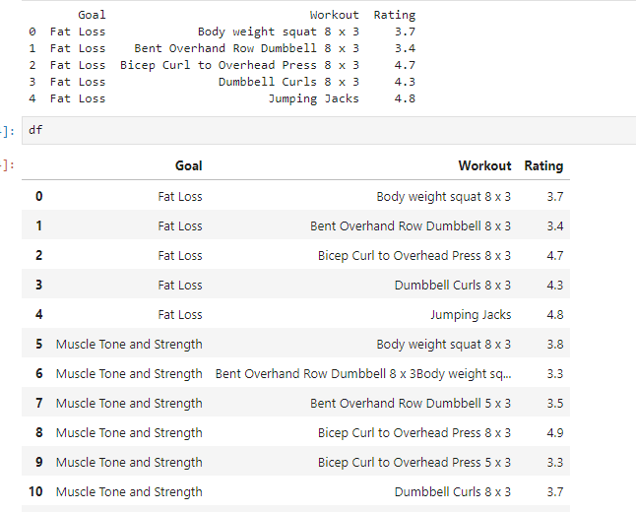
DATASET
EVIDENCE OF COMPLETION
IT21114144 | Herath M.H.S.M | R24-122

Slide 35
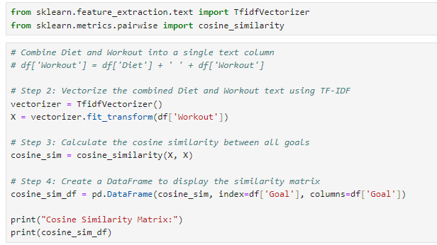
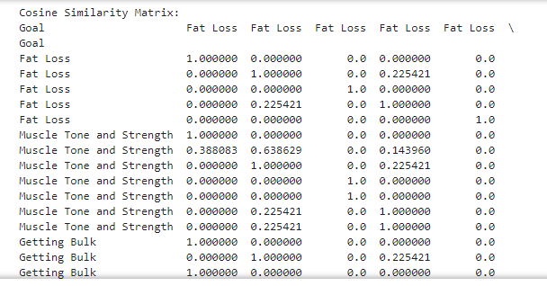
COSINE SIMILARITY

Slide 36
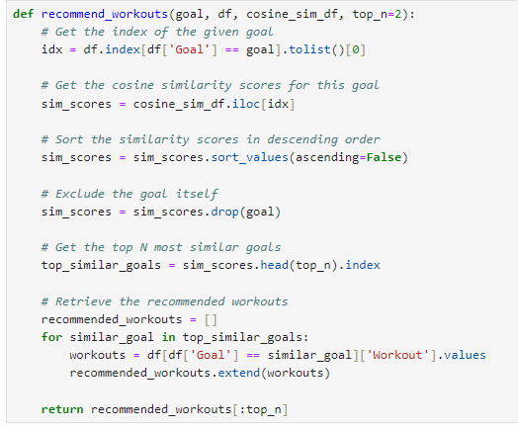
CREATING WORKOUT PLANS
IT21114144 | Herath M.H.S.M | R24-122

Slide 37


TESTING AND OUTPUT
IT21114144 | Herath M.H.S.M | R24-122

Slide 38

TECHNOLOGIES
Flutter
JUPYTER NOTEBOOK
PYTHON
IT21114144 | Herath M.H.S.M | R24-122

Slide 39
OVERALL PROGRESS
Completed Tasks
Identify the Problem
Research & Data Gathering
Implementing Recommender System
On going Tasks
Tasks yet to start
Frontend Implementation
Submit the Research Paper
User Interface Design
90%
Progress Tracking and Send notifications
Integration
Deployment & Evaluation

Slide 40
FUTURE WORKS
Track the progress and send remainders to user
Integration
Testing

Slide 41

WORK BREAKDOWN STRUCTURE
IT21114144 | Herath M.H.S.M | R24-122

Slide 42
IT21002106​ | Herath H.M.R.B
Specialization – Information Technology
IT21002106​ | Herath H.M.R.B | R24-122

Slide 43
Exercise Movement Tracking System with Real-Time Feedback​
COMPONENT
03
IT21002106​ | Herath H.M.R.B | R24-122

Slide 44

BACKGROUND
How crucial are proper exercise movements and poses for achieving fitness goals?​
Developing the effectiveness and precision of fitness training by integrating cutting-edge technologies into the workout experience. By addressing, ​
Tracking exercise movements during workouts.
Providing real-time feedback.
IT21002106​ | Herath H.M.R.B | R24-122

Slide 45

Why We Address?
Incorrect exercise poses can lead to ineffective workouts or, in some cases, increase the risk of injury.
Coaches may struggle to correct users' form and poses when evaluating recorded workouts.
How can Digital system track real time poses and movements during the exercise?
IT21002106​ | Herath H.M.R.B | R24-122

Slide 46

Specific Objective
Sub Objective
Implement computer vision and machine learning to provide real-time feedback for correcting exercise poses during workouts.
Data Collection and Preprocessing
Develop the algorithms to real-time Exercise Movement Tracking
Optimized real-time Feedback Integration and Enhanced User Experience
​
IT21002106​ | Herath H.M.R.B | R24-122

Slide 47
SYSTEM DIAGRAM
IT21002106​ | Herath H.M.R.B | R24-122

Slide 48



FIGMA UI
IT21002106 | Herath H.M.R.B | R24-122

Slide 49
Completed Tasks
Data Preprocessing & Preparing
Problem Identification
Research & Data Collection
On going Tasks
Model Development & Computer Vision Algorithm
Fine Tuning the Model & Algorithm
Tasks yet to start
OVERALL PROGRESS
Capture Videos and Obtain real-time Predictions
Author a research paper and submit
Improve the User Interface Design
Testing
90%
User Interface Design
Deployment & Evaluation
Integration
commercialization

Slide 50


TECHNOLOGIES
Flutter
python
Firebase
MediaPipe
Yolo
IT21002106​ | Herath H.M.R.B | R24-122

Slide 51


EVIDENCE OF COMPLETION
Identify Incorrect Exercise Movement & Give The Real-Time Feedback
IT21002106 | Herath H.M.R.B | R24-122

Slide 52


EVIDENCE OF COMPLETION
Test & Outputs
IT21002106 | Herath H.M.R.B | R24-122

Slide 53



EVIDENCE OF COMPLETION
Frontend Implementation
IT21002106 | Herath H.M.R.B | R24-122

Slide 54


EVIDENCE OF COMPLETION
Test & Outputs
IT21002106 | Herath H.M.R.B | R24-122

Slide 55
FUTURE WORKS
Enhance the User Interface
Optimize the computer vision algorithm
Commercialization

Slide 56

WORK BREAKDOWN STRUCTURE
IT21002106​ | Herath H.M.R.B | R24-122

Slide 57
IT21128936 | Rajakaruna R.H.M.S.A
Specialization – Information Technology
IT21128936 | Rajakaruna R.H.M.S.A | R24-122

Slide 58
04
PERSONALIZED DIETARY PLAN​ RECOMMENDATION SYSTEM​
COMPONENT
IT21128936 | Rajakaruna R.H.M.S.A | R24-122

Slide 59

BACKGROUND
Do you know what is daily calorie intake ?​
The total number of calories a person consumes in a day to maintain their body's energy needs and functions.​
IT21128936 | Rajakaruna R.H.M.S.A | R24-122

Slide 60

BMR - Basal Metabolic Rate
Number of calories our body needs to maintain basic physiological functions.
For men: BMR = 88.362 + (13.397 × weight in kg) +
(4.799 × height in cm) - (5.677 × age in years)
For women: BMR = 447.593 + (9.247 × weight in kg) +
(3.098 × height in cm) - (4.330 × age in years)
IT21128936 | Rajakaruna R.H.M.S.A | R24-122

Slide 61

Adjust BMR according to
Activity Level
BMR × 1.2
BMR × 1.375
BMR × 1.55
BMR × 1.725
BMR × 1.9
IT21128936 | Rajakaruna R.H.M.S.A | R24-122

Slide 62


Adjust BMR according
to Goal
BMR
BMR - 400 calories
BMR + 250 calories
Final Calorie Limit
IT21128936 | Rajakaruna R.H.M.S.A | R24-122

Slide 63
SYSTEM DIAGRAM
IT21128936 | Rajakaruna R.H.M.S.A | R24-122

Slide 64
Completed Tasks
Data Preprocessing & Preparing
Problem Identification
Research & Data Collection
On going Tasks
Model Development
Fine Tuning the Model & Algorithm
Tasks yet to start
OVERALL PROGRESS
Frontend Development
Author a research paper and submit
Improve the User Interface Design
Hosting
90%
User Interface Design
Deployment & Evaluation
Integration
commercialization

Slide 65
TECHNOLOGIES
FLUTTER
PYTHON
JUPYTER NOTEBOOK
IT21128936 | Rajakaruna R.H.M.S.A | R24-122

Slide 66



EVIDENCE OF COMPLETION
DATASETS
IT21128936 | Rajakaruna R.H.M.S.A | R24-122

Slide 67




DATA PREPROCESSING
Check Null Values
Check Duplicate Values
IT21128936 | Rajakaruna R.H.M.S.A | R24-122

Slide 68




DAILY CALORIE LIMIT GENERATION
IT21128936 | Rajakaruna R.H.M.S.A | R24-122

Slide 69




MEAL PLAN GENERATION
IT21128936 | Rajakaruna R.H.M.S.A | R24-122

Slide 70


EVIDENCE OF COMPLETION
Frontend Implementation
IT21002106 | Herath H.M.R.B | R24-122

Slide 71




EVIDENCE OF COMPLETION
Test & Outputs
IT21002106 | Herath H.M.R.B | R24-122

Slide 72
FUTURE WORKS
Integration with user profile
Improve User Interface Design
AWS hosting

Slide 73

WORK BREAKDOWN STRUCTURE
IT21128936 | Rajakaruna R.H.M.S.A | R24-122

Slide 74
COMMERCIALIZATION​
MARKETPLACE
FREE VERSION
Make the app accessible to users of all ages without age limitations.
Easy to use for individuals without advanced technology knowledge.
Provide educational resources within the app to guide users on fitness and nutrition principles.
Identification of Body Types.
Real-time Exercise Feedback.
Dietary Recommendations.
Personalized Workout Plans.
TARGET AUDIENCE
PREMIUM VERSION
Fitness Enthusiasts
Health-conscious Individuals
Gym-goers
Personal Trainers
Advanced Body Analysis.
Advanced Real-time Exercise Feedback.
A wider variety of diet plans and workout options.

Slide 75

BUDGET
Component | Price
Travelling cost | RS. 20000
Developers' value of time | RS. 100,000
Database Price | RS. 7000
Play store publishing | RS. 9000
Marketing and Advertisements | RS. 14000
Total Value of the application | RS. 150,000

Slide 76
THANK YOU !

